Slide 1

Data Analytics and Visualization (24DSB3101) Comparative Study of Recommendation Systems Using Machine Learning
Under the Esteemed guidance of
Dr K. Swapnika
Assistant Professor
Department Of Computer Science and Engineering
Submitted by: Batch 6
Team Members:
2420080028 –Harini Priya
2420080041 – K.Soumya
2420080067–M.Abhiram Reddy
2420080084 –Arshiya Naaz

Slide 2
Contents
Introduction / Abstract
Problem Statement
Project Objectives
Literature Survey
Project flow diagram
Research Gap Identification
Novelty
Innovation
Feasibility & Project Plan

Slide 3
Introduction
The proposed project focuses on the comparative analysis of different recommendation system techniques used to provide personalized recommendations.
The study considers popularity-based recommendation, content-based filtering, collaborative filtering, matrix factorization and machine learning-based recommendation models.
The project aims to compare these approaches using standard recommendation and rating-prediction metrics and identify suitable approaches for different recommendation scenarios.

Slide 4
Problem Statement
Recommendation systems help users discover relevant items such as movies, products and books from large collections. However, different recommendation techniques perform differently depending on user preferences, item characteristics, available data and the application domain.
Therefore, this project aims to conduct a systematic comparative study of different recommendation system techniques and machine learning models using benchmark datasets. The study will evaluate recommendation quality, prediction accuracy, computational complexity and scalability to identify suitable approaches for different real-world applications.

Slide 5
Objectives
Data Preparation – Collect and preprocess recommendation datasets.
EDA – Analyze users, items, ratings, and data quality.
Popularity-Based – Recommend popular items.
Content-Based – Recommend similar items using features.
Collaborative Filtering – Recommend based on user/item similarities.
Matrix Factorization – Apply SVD and NMF techniques.
ML Models – Predict ratings using machine learning models.
Evaluation – Measure model performance using different metrics.
Comparison – Compare accuracy, quality, and scalability.
Applications – Select suitable methods for real-world systems.

Slide 6
Literature Survey
Year | Author(s) | Paper / Research Area | Method / Finding | Gap / Relevance
2001 | Sarwar, Karypis, Konstan & Riedl | Item-Based Collaborative Filtering Recommendation Algorithms | Studies item-based collaborative filtering using item-item relationships for recommendations. | Provides an important foundation for collaborative filtering; sparsity and scalability remain relevant.
2003 | Linden, Smith & York | Amazon.com Recommendations: Item-to-Item Collaborative Filtering | Introduces item-to-item collaborative filtering for large-scale commercial recommendation. | Highly relevant to e-commerce recommendation but focuses mainly on item-based filtering.
2009 | Koren, Bell & Volinsky | Matrix Factorization Techniques for Recommender Systems | Demonstrates the effectiveness of matrix factorization for learning latent user-item relationships. | Strong foundation for latent-factor modelling; computational requirements remain relevant.
2010 | Koren | Collaborative Filtering with Temporal Dynamics | Incorporates temporal changes in user preferences into collaborative filtering. | Shows the importance of changing preferences but increases modelling complexity.
2014 | He & Chu | Bayesian Optimization for Recommender Systems | Discusses optimization approaches for recommendation-system development. | Useful for understanding optimization but not focused on a complete comparative framework.

Slide 7
2015 | Zhang, Yao & Sun | Deep Learning Based Recommender Systems | Explores deep learning approaches for learning complex recommendation patterns. | Deep models can be powerful but may require more data and computational resources.
2017 | He et al. | Neural Collaborative Filtering | Uses neural networks to model user-item interactions for recommendation. | Flexible modelling but more complex than traditional collaborative filtering.
2016 | Covington, Adams & Sargin | Deep Neural Networks for YouTube Recommendations | Uses deep neural networks for large-scale video recommendation. | Demonstrates scalability but requires large-scale infrastructure.
2018 | Zhang, Chen et al. | Explainable Recommendation: A Survey and New Perspectives | Reviews methods for providing explanations for recommendation results. | Highlights the importance of interpretability in recommendation systems.
2019 | Zhang, Yao, Sun & Tay | Deep Learning Based Recommender System: A Survey and New Perspectives | Reviews deep-learning-based recommendation methods and applications. | Provides broad coverage and motivates comparison with simpler approaches.

Slide 8
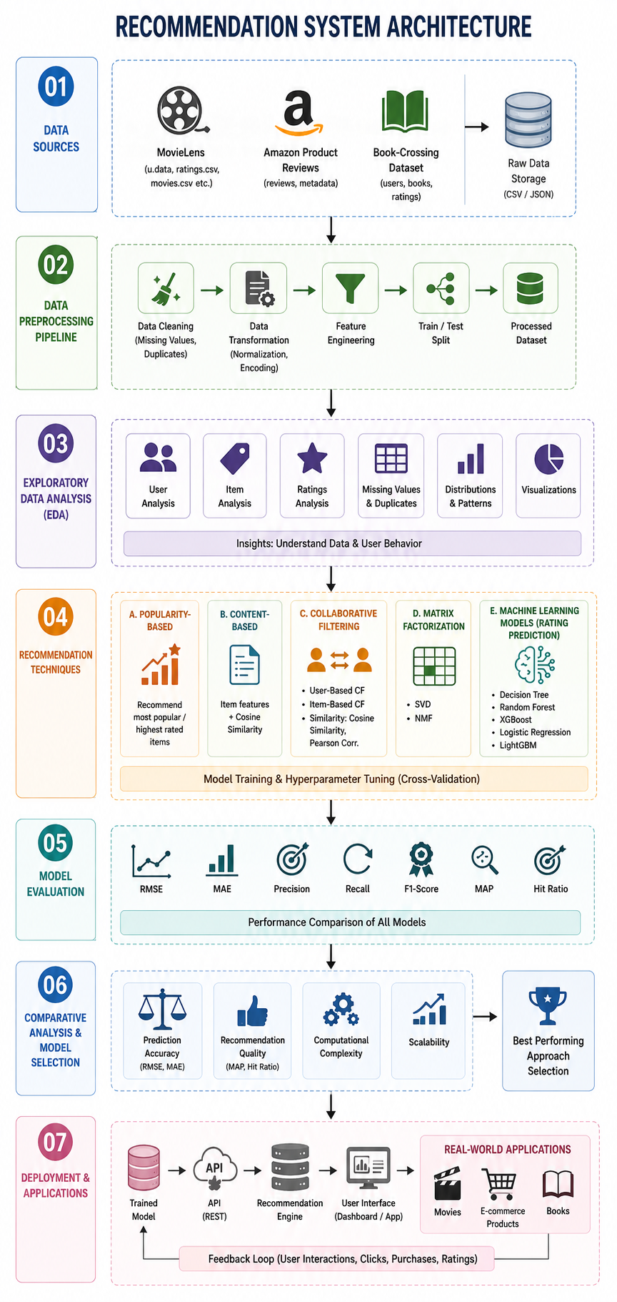
Project Workflow

Slide 9
Research Gap
Many recommendation studies focus on a single technique rather than systematically comparing multiple approaches.
Traditional methods such as popularity-based, content-based and collaborative filtering have different strengths and limitations that need common-framework evaluation.
Matrix factorization methods such as SVD and NMF need comparison with modern machine learning approaches.
Machine learning models such as Random Forest, XGBoost and LightGBM can learn complex patterns, but their recommendation performance should be compared with traditional techniques.
Recommendation performance is often evaluated using rating-prediction metrics, while Precision, Recall, F1-Score and Hit Ratio are also important.
There is a need for a practical framework considering accuracy, recommendation quality, computational complexity and scalability together.
Dataset characteristics can influence recommendation performance, making evaluation across benchmark datasets important.

Slide 10
Novelty
The novelty of the proposed project is not the individual use of recommendation algorithms, since these techniques already exist in the literature. The proposed work focuses on their systematic comparison within a common experimental framework.
Integration of popularity-based, content-based, collaborative filtering and matrix factorization approaches.
Comparison of traditional recommendation techniques with supervised machine learning models.
Evaluation using both rating-prediction metrics and recommendation-quality metrics.
Use of multiple benchmark datasets representing different recommendation domains.
Analysis of trade-offs between accuracy, recommendation quality, computational complexity and scalability.
Development of a unified pipeline for preprocessing, modelling, evaluation and comparative analysis.

Slide 11
Innovation
Feature Engineering&
Feature Selection
↓
Train-Test Split
↓
Recommendation Models
↓
Performance Evaluation
↓
Comparative Analysis
↓
Research Conclusions

Slide 12
Feasibility
Technical Feasibility
The proposed recommendation system can be implemented using Python and open-source libraries such as Pandas, NumPy, Scikit-learn and suitable recommendation-system libraries. The selected benchmark datasets are publicly available.
Economic Feasibility
The project does not require specialized paid software or hardware. Open-source programming tools and publicly available datasets can be used.
Operational Feasibility
The workflow is suitable for an academic project and can be implemented on a standard computer. Individual recommendation models can be developed progressively and evaluated within the planned project duration.

Slide 13
Project Plan
Phase | Weeks | Planned Activity
Phase 1 – Research & Data Collection | Week 1–2 | Literature survey, define objectives and research gaps, and collect datasets.
Phase 2 – Data Preparation & Analysis | Week 3–4 | Data cleaning, preprocessing, EDA, feature engineering, and feature selection.
Phase 3 – Model Development | Week 5–7 | Implement Popularity-Based, Content-Based, Collaborative Filtering, SVD, NMF, and ML models.
Phase 4 – Evaluation & Documentation | Week 8 | Evaluate and compare models, visualize results, prepare documentation, and presentation.

Slide 14
Thank you

